Slide 1
SHARPENING FREQUENCY DOMAIN
PRESENTED BY :
Alvin Dominic Lopez
R8B10

Slide 2
CONTENTS:-
Ideal High Pass Filter
Gaussian High Pass Filter
Butterworth High Pass Filter

Slide 3
Sharpening in Frequency Domain
Sharpening in the frequency domain is a technique used in digital image processing to enhance edges and fine details by emphasizing high-frequency components of an image.
An image contains:
Low-frequency components → Smooth areas (slow intensity changes)
High-frequency components → Edges, sharp details, noise (rapid intensity changes)

Slide 4
Steps Involved :
1.Transform image to frequency domain
Apply Fourier Transform (FT) or Discrete Fourier Transform (DFT)
Practically done using Fast Fourier Transform (FFT)
2.Apply a High-Pass Filter (HPF)
Multiply the frequency spectrum with a high-pass filter
This emphasizes high-frequency components like edges and fine details.
3.Inverse Transform
Apply Inverse Fourier Transform to get the sharpened image back in spatial domain

Slide 5
DIFFERENT TYPES OF FILTERS :
IDEAL HIGH PASS FILTER
GAUSSIAN HIGH PASS FILTER
BUTTERWORTH HIGH PASS FILTER

Slide 6
Ideal High pass filter :-
An Ideal High Pass Filter (IHPF) allows High frequencies to pass and completely blocks low frequencies.
Low frequencies includes smooth areas of image High frequencies includes edges, sharp details, noise
So, an Ideal High Pass Filter enhances edges and fine details, making the image sharper.
Why is it called “Ideal”?
Because it makes a perfect cut:
Inside a fixed radius → 100% passed
Outside that radius → 0% passed
There is no gradual change.

Slide 7

How It Works :-
Convert image into frequency domain (using FFT).
Draw a circle at the center (cutoff frequency $D_{0}).$
Remove values inside the circle (low frequencies).
Keep values outside the circle (high frequencies).
Convert back to spatial domain.
Usage of Ideal High Pass Filters
Edge Detection
Highlighting Fine Details
Image Sharpening
Preprocessing for Feature Extraction in Image Processing

Slide 8
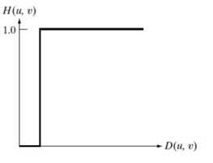
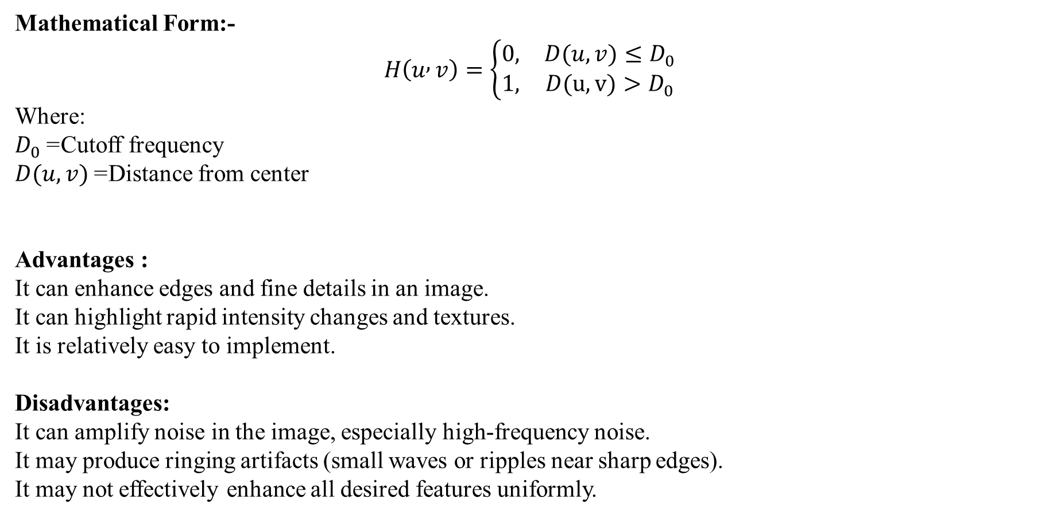
Mathematical Form:-
$$H\left(u , v\right)=\left\{\begin{matrix}0, & D(u,v)≤D_{0} \\ 1, & D(u,v)>D_{0}\end{matrix}\right.$$
Where:
$D_{0}$= Cutoff frequency
$D(u,v)$= Distance from center
Advantages :
It can enhance edges and fine details in an image.
It can highlight rapid intensity changes and textures.
It is relatively easy to implement.
Disadvantages:
It can amplify noise in the image, especially high-frequency noise.
It may produce ringing artifacts (small waves or ripples near sharp edges).
It may not effectively enhance all desired features uniformly.

Slide 9
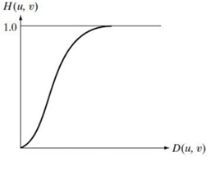
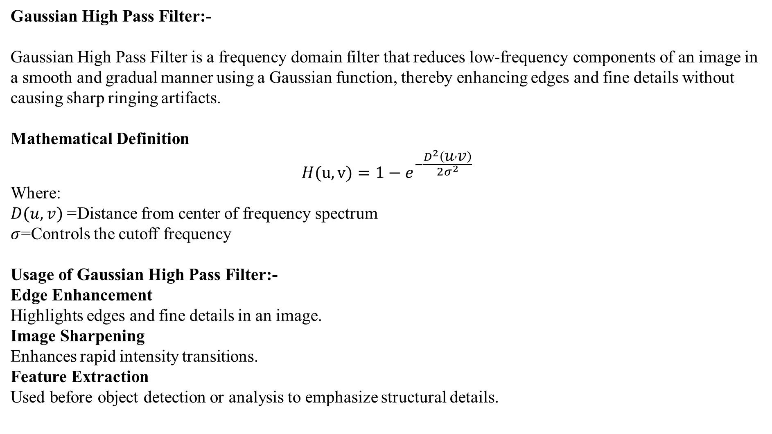
Gaussian High Pass Filter:-
Gaussian High Pass Filter is a frequency domain filter that reduces low-frequency components of an image in a smooth and gradual manner using a Gaussian function, thereby enhancing edges and fine details without causing sharp ringing artifacts.
Mathematical Definition
$$H(u,v)={1−e}^{−\frac{D^{2}\left(u , v\right)}{2σ^{2}}}$$
Where:
$D(u,v)$= Distance from center of frequency spectrum
$σ$=Controls the cutoff frequency
Usage of Gaussian High Pass Filter:-
Edge Enhancement Highlights edges and fine details in an image.
Image Sharpening Enhances rapid intensity transitions.
Feature Extraction Used before object detection or analysis to emphasize structural details.

Slide 10
Advantages
No Ringing Effect
Smooth transition avoids ripples near edges.
Edge Enhancement Enhances important edge details instead of blurring them.
Mathematically Simple
Based on Gaussian function and easy to implement.
Disadvantages
Amplifies Noise High-frequency noise may become more visible.
Over-Sharpening Excess enhancement can make the image look unnatural.
Computational Cost Requires Fourier transform in frequency domain.

Slide 11

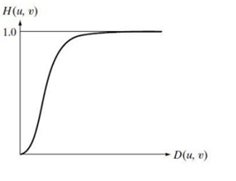
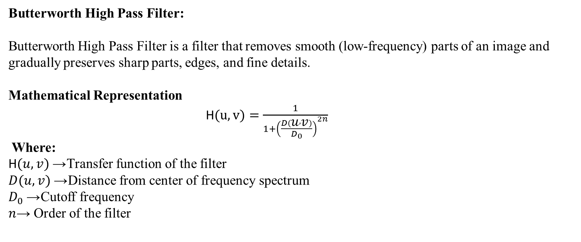
Butterworth High Pass Filter:
Butterworth High Pass Filter is a filter that removes smooth (low-frequency) parts of an image and gradually preserves sharp parts, edges, and fine details.
Mathematical Representation
H$(u,v)=\frac{1}{1+{\left(\frac{D\left(u , v\right)}{D_{0}}\right)}^{2n}}$
Where:
H$(u,v)$→ Transfer function of the filter
$D(u,v)$→ Distance from center of frequency spectrum
$D_{0}$→ Cutoff frequency
$n$→ Order of the filter

Slide 12
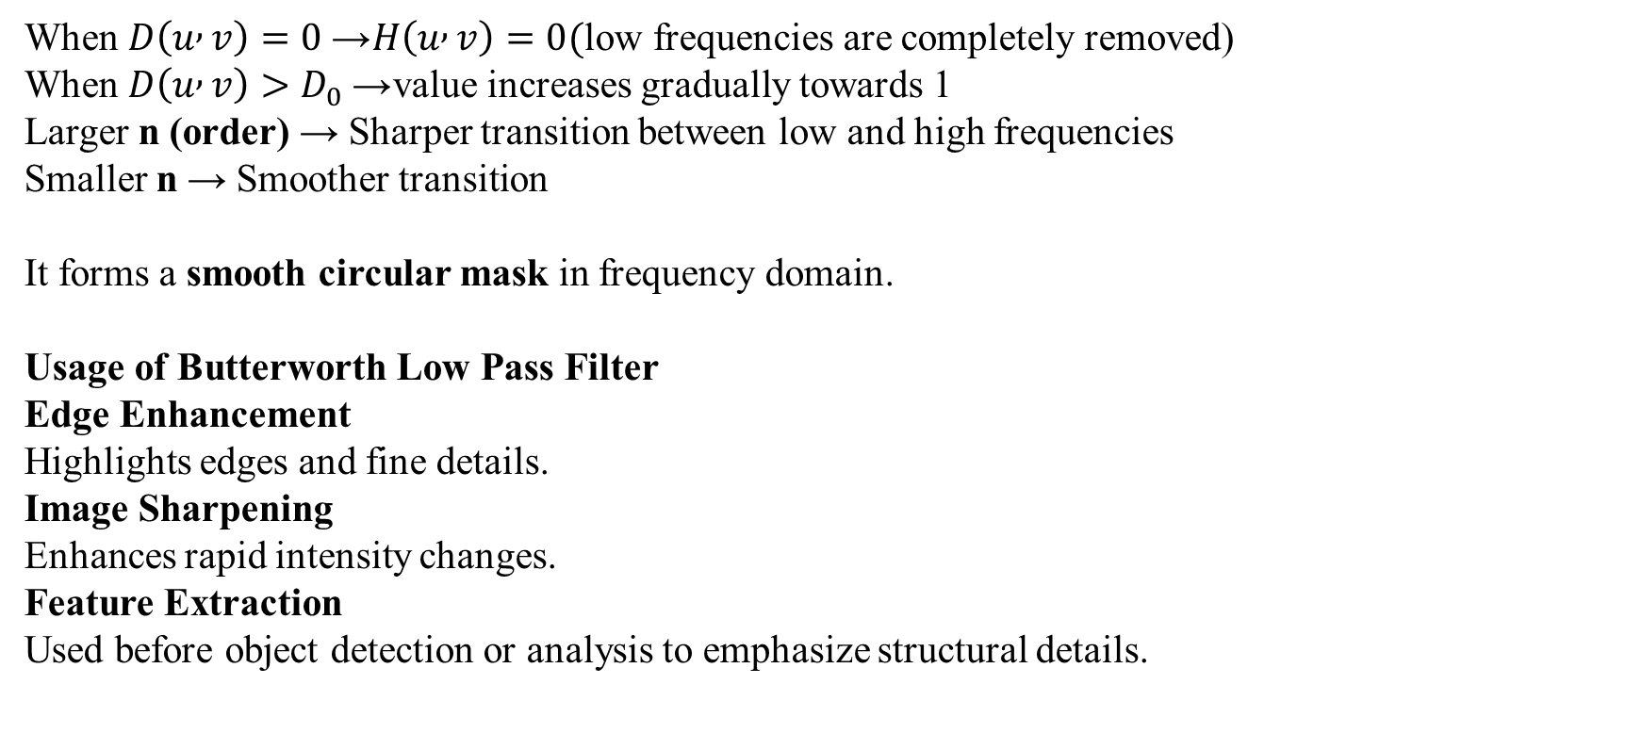
Important points about representation:-
When $D\left(u , v\right)=0$→ $H\left(u , v\right)=0($low frequencies are completely removed) When $D\left(u , v\right)>D_{0}$→ value increases gradually towards 1 Larger n (order) → Sharper transition between low and high frequencies Smaller n → Smoother transition
It forms a smooth circular mask in frequency domain.
Usage of Butterworth Low Pass Filter
Edge Enhancement Highlights edges and fine details.
Image Sharpening Enhances rapid intensity changes.
Feature Extraction Used before object detection or analysis to emphasize structural details.

Slide 13
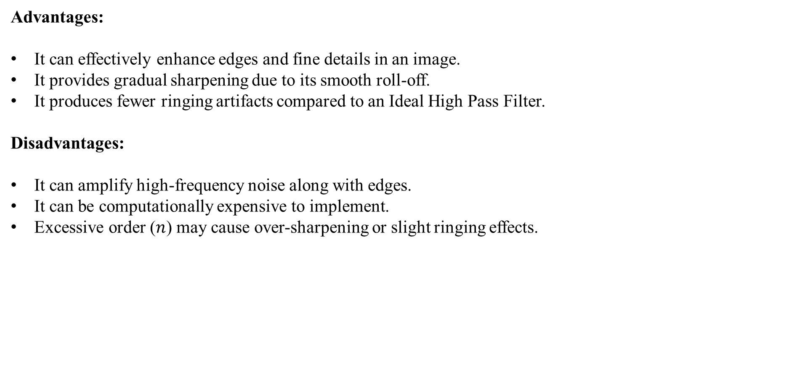
Advantages:
It can effectively enhance edges and fine details in an image.
It provides gradual sharpening due to its smooth roll-off.
It produces fewer ringing artifacts compared to an Ideal High Pass Filter.
Disadvantages:
It can amplify high-frequency noise along with edges.
It can be computationally expensive to implement.
Excessive order ($n$) may cause over-sharpening or slight ringing effects.

Slide 14
THANK YOU

